Slide 1
Who was the G.O.A.T.?
An analysis of basketball’s biggest names...
Mat Lockhart & Thomas Baskin

Slide 2
Objective
Three criteria:
Offense
Defense
Overall wins
LeBron James, Michael Jordan, Kareem Abdul-Jabbar, and Bill Russel

Slide 3
Web Scraping
We used BeautifulSoup to scrape www.basketball-reference.com for basketball statistics for the top players.
This website was organized and consistent in its use and shape of tables.
https://www.basketball-reference.com/

Slide 4
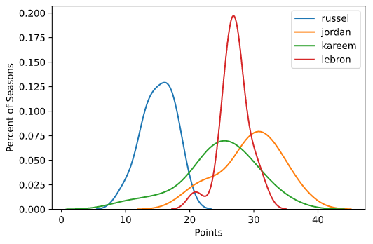
Offense
Here we compare each players’ season points with their percentage of all seasons.

Slide 5
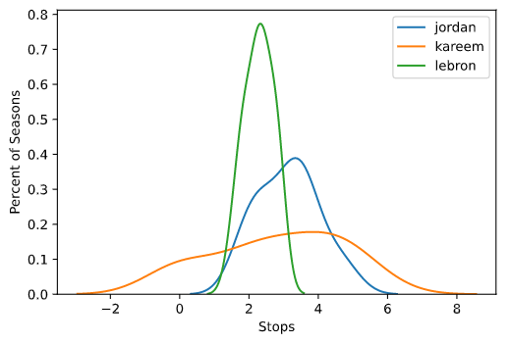
Defense
Note: Bill Russel

Slide 6
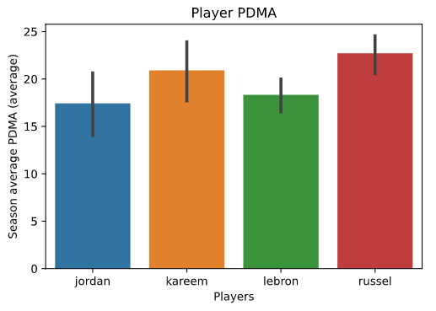
Custom Statistic
Divide points by field goal percentage, add blocks, steals, rebounds, and assists, take away turnovers and fouls, and multiply by number of games played in the season, divided by 100.

Slide 7
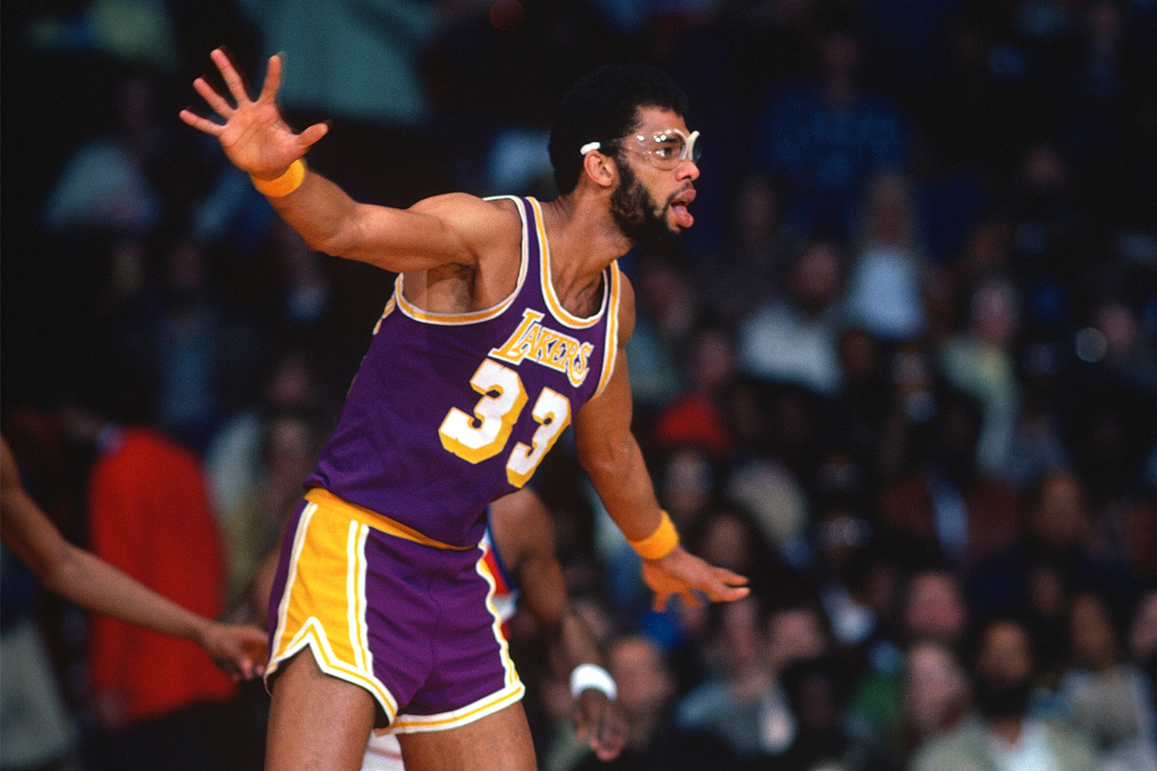
Championship Wins
LeBron has 4
Kareem and Jordan have 6
Bill Russel has 11
How could have the game been
different when Bill Russel played?

Slide 8
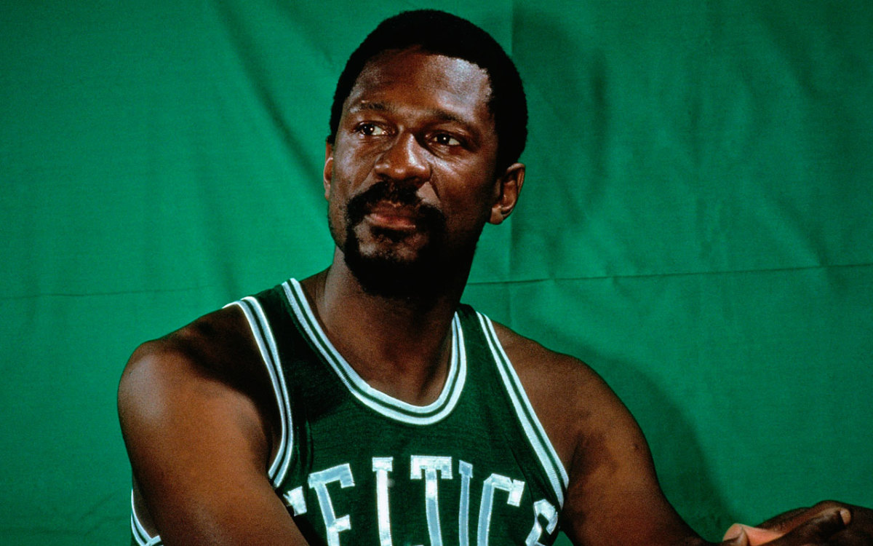
Who is the G.O.A.T.?
Due to winning in 2 of 4 categories, and losing one only because statistics were not recorded then. We declare Bill Russel to be the basketball G.O.A.T., the Greatest of All Time.
Limitations

